Slide 1
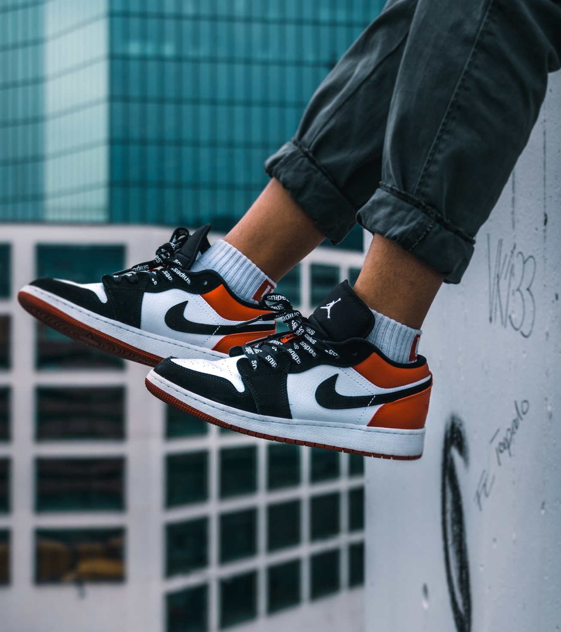


UNDERSTANDING & QUANTIFYING BRAND EQUITY
Presented by Lindsey Aliksanyan

Slide 2

"BRAND BUILDING IS MORE IMPORTANT IN A DIGITAL WORLD THAN IT IS IN THE OLD ECONOMY.
MOST MARKETERS HAVE LEARNED COMPLETELY THE WRONG LESSON.
THEY'VE SEEN THE EFFICIENCY OF SHORT-TERM ACTIVATION AND THEY PUT ALL THEIR MONEY IN THERE."
- LES BINET
DDB & CO-AUTHOR,
THE LONG AND SHORT OF IT

Slide 3
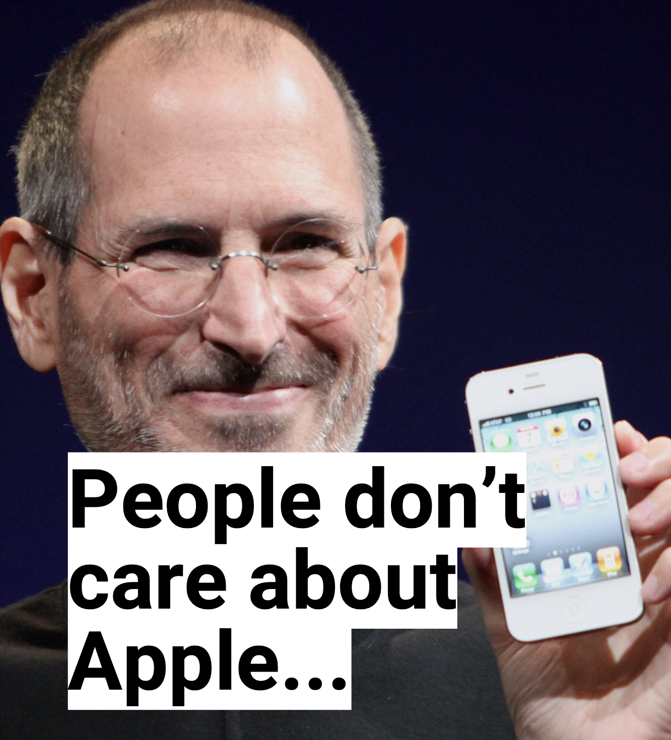

Slide 4
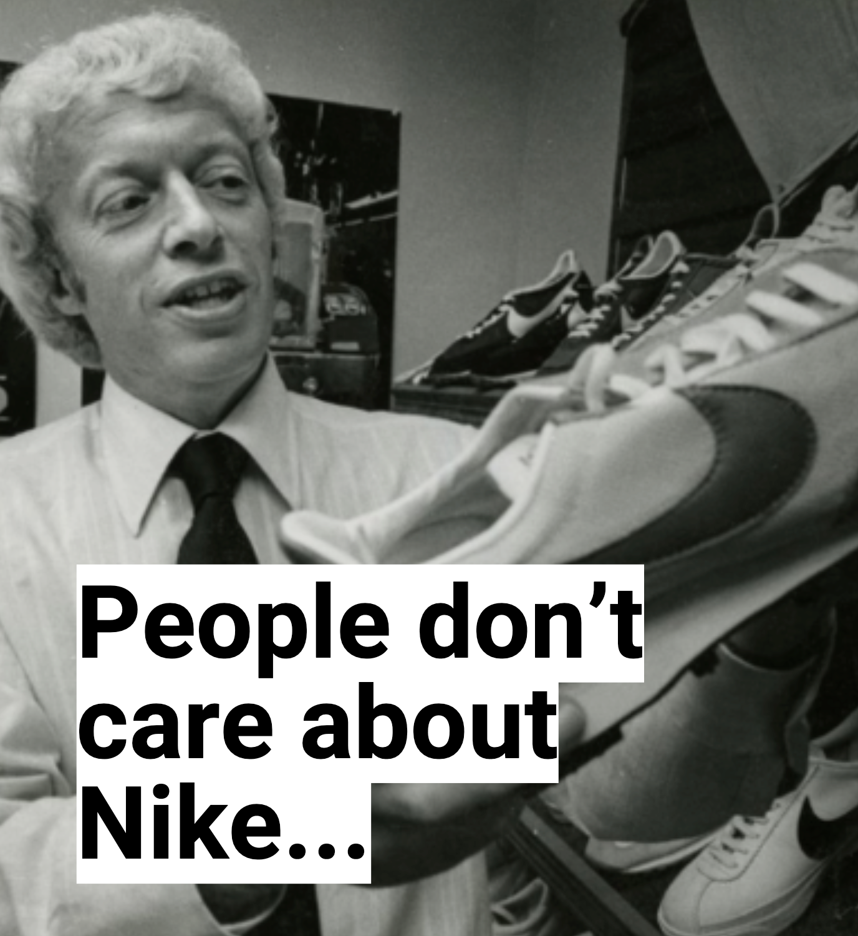

Slide 5


Slide 6


Slide 7
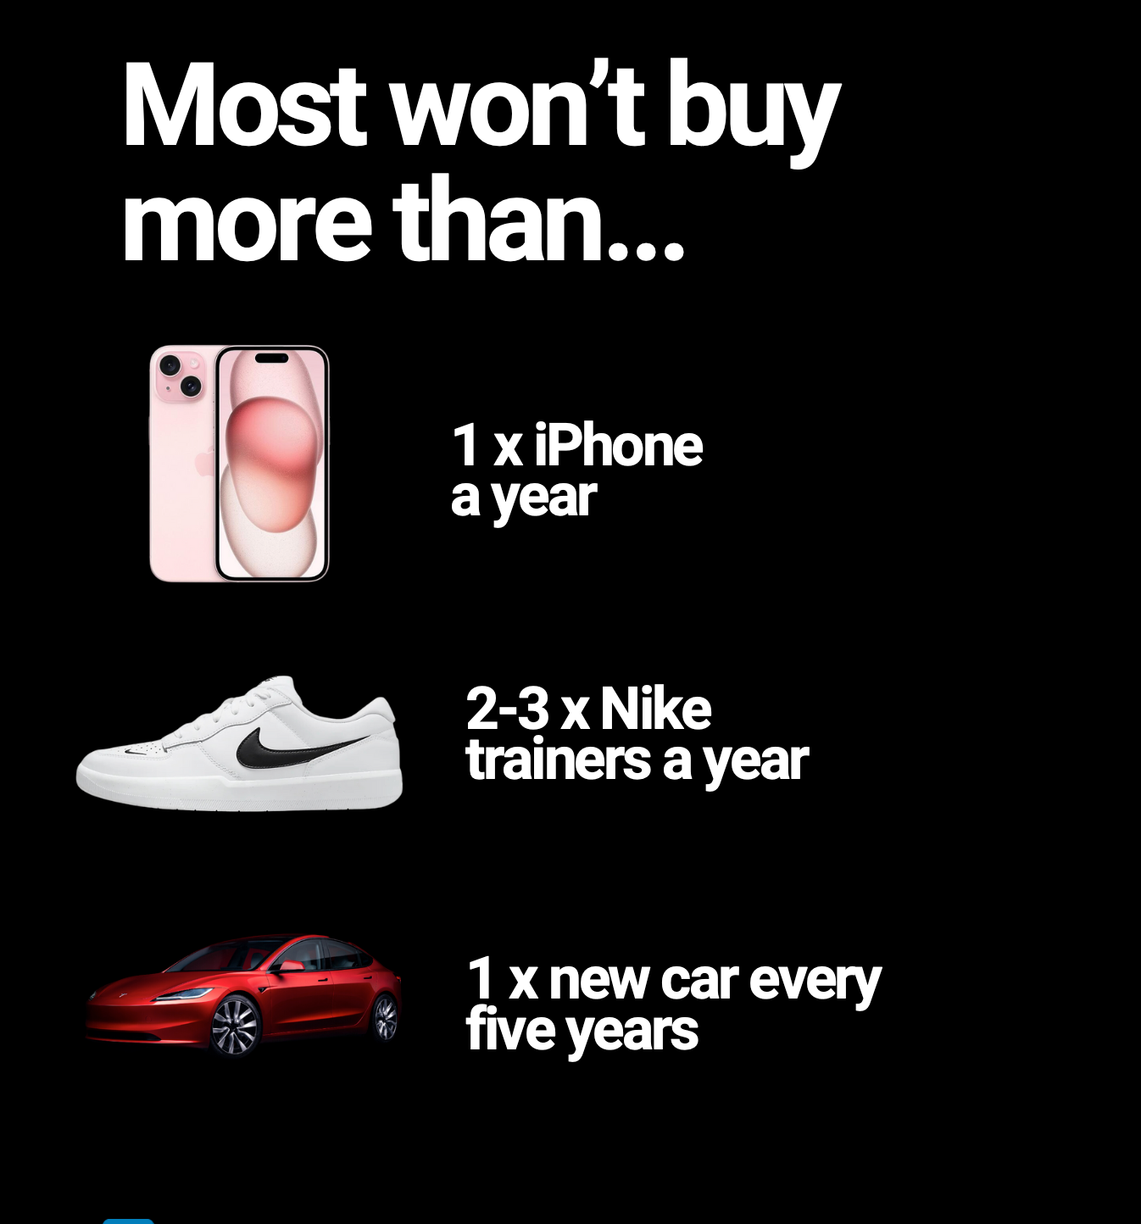

Slide 8


Slide 9
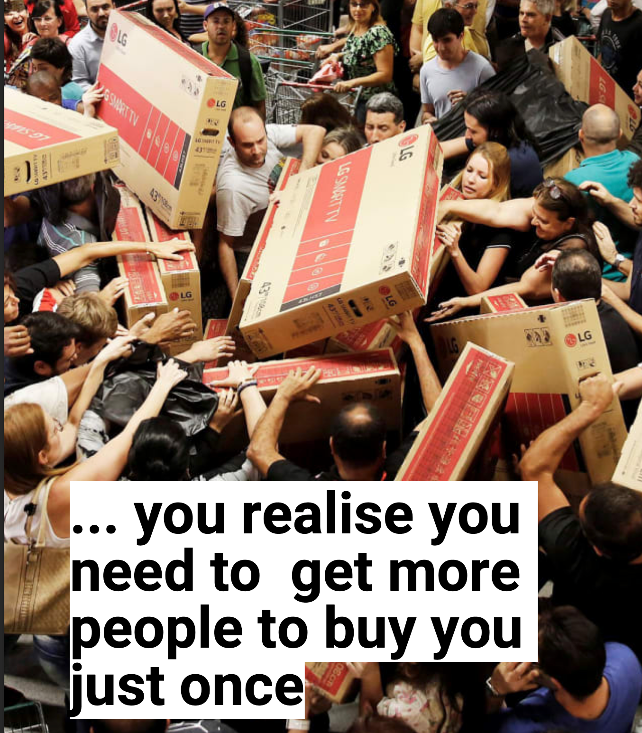

Slide 10


Slide 11
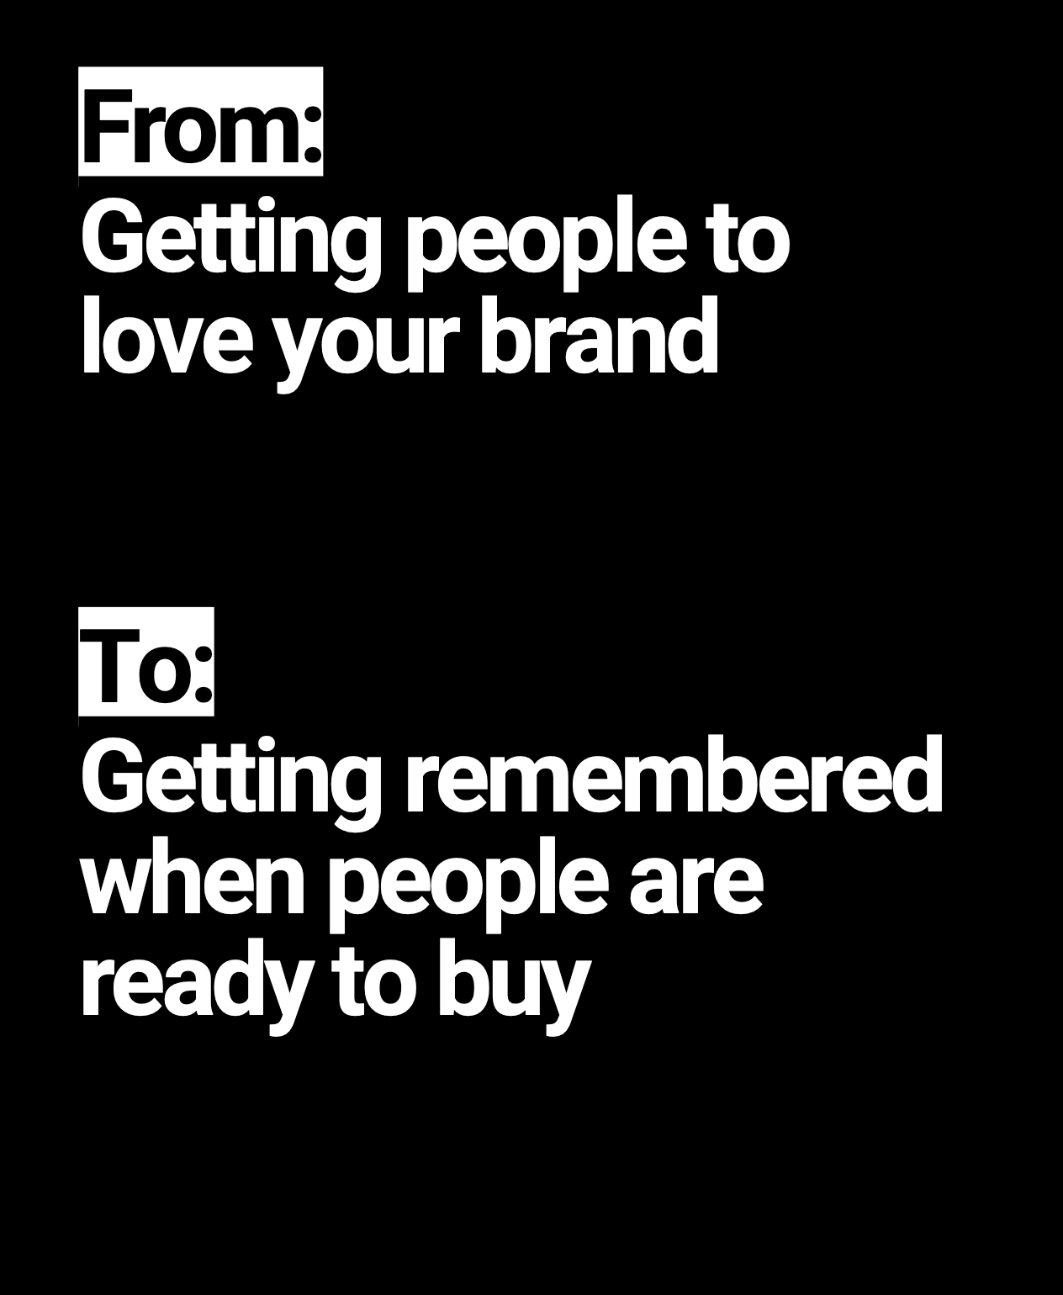


Slide 12
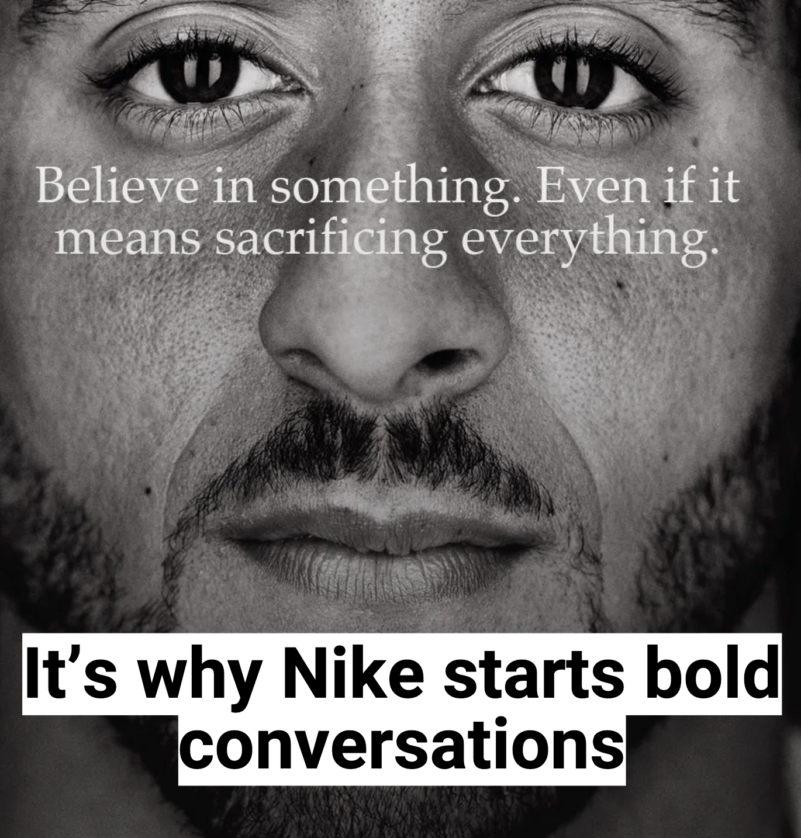



Slide 13

THE TRUTH ABOUT BRANDS: PEOPLE DON'T CARE (AS MUCH AS YOU THINK)
People don't care about brands
  People have limited capacity to buy from any brand, regardless of how much they may 'love' it.
People have limited purchasing capacity
  Most people will only buy 1 iPhone per year, 2-3 Nike trainers per year, and 1 new car every 5 years.
Focus on getting remembered
  Instead of trying to get the same people to buy more, you need to get more people to buy from you just once.
Embrace bold strategies
  The best strategies aim for fame, get you top of mind, and spark bold conversations - like Nike, Apple, and Tesla.
Your job is to get remembered
  When people are ready to buy, you want your brand to be the one they think of first.
©2025 Proprietary and Confidential. All Rights Reserved.

Slide 14









LINDSEY ALIKSANYAN
I’ve spent my career helping brands understand their place in the market, measure their impact, and grow with purpose.
My work sits at the intersection of strategy, data, and culture, combining brand equity measurement, competitive intelligence, and business insights to guide companies in making informed decisions.
©2025 Proprietary and Confidential. All Rights Reserved.

Slide 15

BRAND EQUITY COMPARISON
Percent of consumers who perceive each brand as having strong equity
85%
65%
45%
Nike
Adidas
Under Armour
©2025 Proprietary and Confidential. All Rights Reserved.

Slide 16
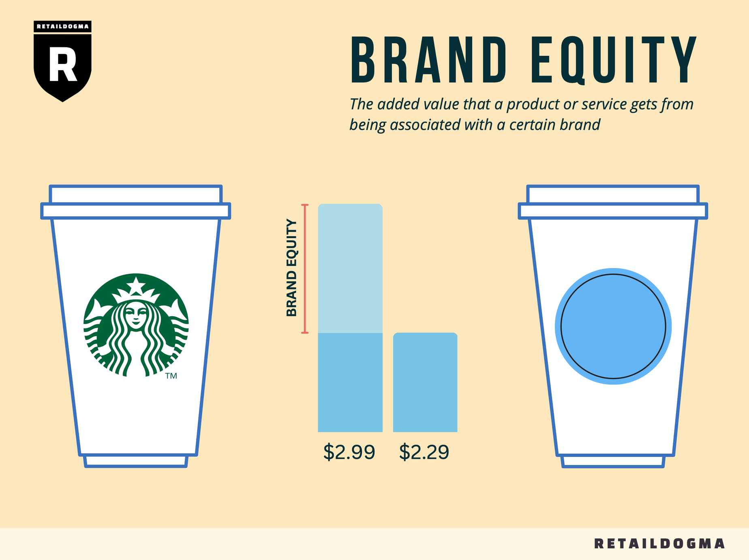
UNDERSTANDING & QUANTIFYING BRAND EQUITY
Brand equity refers to the intangible value that a brand holds in the minds of consumers. It determines how customers perceive a brand beyond its products and services, allowing companies to charge premium prices, maintain customer loyalty, and enhance market share resilience.
©2025 Proprietary and Confidential. All Rights Reserved.
Notes:
"Brand equity is a critical but often misunderstood asset for businesses. We all know that strong brands drive loyalty, pricing power, and long-term growth—but how do we actually measure it? Today, we’re going to break down a structured, data-driven approach to quantifying brand equity, exploring how brands like Nike, Adidas, and others build and sustain their value over time."

Slide 17

THE FOUR PILLARS OF BRAND EQUITY
Brand Awareness
Brand Esteem
Brand Association
How well is the brand recognized by consumers? Measured by brand mentions, media exposure, and search volume.
Is the brand perceived as high-quality and respected? Measured by sentiment analysis, customer reviews, and trust scores.
What emotions and values do consumers associate with the brand? Measured by brand differentiation, resonance, and brand confusion.
Brand Loyalty
Brand Esteem = Trust, reliability, and quality. Brand Association = Emotional and cultural connection to the brand.
How committed are customers to the brand? Measured by retention rate, engagement levels, and advocacy.
©2025 Proprietary and Confidential. All Rights Reserved.
Notes:
The Four Pillars of Brand EquityPillarWhat It MeasuresKey MetricsBrand AwarenessHow well is the brand recognized?Brand mentions, media exposure, search volumeBrand EsteemPerceived trust, quality, and reputation of the brand.NPS (Net Promoter Score), sentiment analysis, trust ratingsBrand AssociationEmotional & cultural connections with the brand.Brand differentiation, thematic analysis, consumer perception surveysBrand LoyaltyCustomer commitment & repeat purchases.Retention rate, engagement levels, brand advocacy
Why Esteem & Association Are Separate:
Brand Esteem drives consumer confidence and justifies pricing premiums (e.g., Rolex = high Esteem, but not necessarily high emotional connection).
Brand Association determines brand affinity and cultural fit (e.g., Apple = strong Association due to lifestyle appeal).
A brand can have high Esteem but low Association (e.g., Goldman Sachs is highly respected but lacks broad emotional appeal).
A brand can have high Association but low Esteem (e.g., Shein is culturally relevant but lacks premium trust perception).
How This Impacts the Brand Equity Score:
BrandEquityScore=(Awareness×W1)+(Esteem×W2)+(Association×W3)+(Loyalty×W4)Key Takeaway: Keeping these dimensions separate allows better diagnosis of brand strengths & weaknesses, leading to more precise strategy adjustments.

Slide 18




MEASURING AND EXTRACTING BRAND AWARENESS
Social Listening Analysis
Search Trend Analysis
PR & Media Coverage
Use tools like Meltwater, Sprinklr, or Brandwatch to collect total brand mentions (tagged & untagged) on social media and news sources. Filter by time period, region, and platforms to segment the data. Measure share of voice (SOV) against competitors.
Use Google Trends, SEMrush, or Ahrefs to measure search volume trends. Compare branded keyword growth over 12-24 months to understand the brand's online discoverability.
Leverage Factiva or Nexis Uni to pull historical press mentions. Categorize articles by tone (positive, neutral, negative) to gauge media sentiment surrounding the brand.
©2025 Proprietary and Confidential. All Rights Reserved.

Slide 19

MEASURING BRAND ESTEEM
Net Promoter Score (NPS) Tracking
Customer Sentiment Analysis
Media Sentiment Analysis
Aggregate customer reviews from Trustpilot, Google Reviews, and other sources, then classify the sentiment as positive, neutral, or negative. Assign weighted sentiment scores based on the credibility of the review source.
Use survey tools like Qualtrics or SurveyMonkey to compute the Net Promoter Score, which is the percentage of promoters (9-10 rating) minus the percentage of detractors (0-6 rating).
Analyze brand-related media sentiment over a 12-month period using tools like Brandwatch or Meltwater. This provides insights into how the brand is being portrayed in the broader media landscape.
Normalize the results to a 0-100 scale, with top brands like Nike scoring around +72 and Adidas around +55.
©2025 Proprietary and Confidential. All Rights Reserved.
Notes:
"Esteem is about trust and perceived quality. This is measured through:
✔ Net Promoter Score (NPS): How many people would recommend the brand?
✔ Customer Sentiment Analysis: What are customers saying in reviews and feedback?
✔ Media Sentiment: Is the press coverage reinforcing the brand’s reputation or damaging it?"

Slide 20

MEASURING AND EXTRACTING BRAND ASSOCIATION
Social Media Clustering & Thematic Analysis
Consumer Perception Surveys
Brand Conflation Analysis
Use Ipsos, Qualtrics, or Nielsen Panels to assess consumer perception alignment with brand values. Design questions to measure emotional connection, values, and differentiation.
Use AI-driven sentiment tools (Brandwatch, custom developed tools, Semantria, Meltwater) to categorize consumer discussions on social media. Identify recurring themes related to sustainability, activism, and quality.
Use focus groups or competitor sentiment mapping to measure brand confusion versus competitors. For example, determine if consumers mistake Nike's mission for Adidas.
©2025 Proprietary and Confidential. All Rights Reserved.
Notes:
Association is about emotional and cultural relevance. We use:
✔ Surveys to gauge consumer perception.
✔ Social Media Clustering to identify key brand themes.
✔ Brand Conflation Analysis to check if consumers mistake one brand’s identity for another.
Nike, for example, is strongly linked to performance, empowerment, and innovation—all factors that strengthen its Association Score.

Slide 21

MEASURING AND EXTRACTING BRAND LOYALTY
Engagement & Community Growth
Customer Retention Analysis
Brand Advocacy Measurement
Use Shopify, Salesforce, or HubSpot CRM to measure repeat purchase rates. Segment customers by purchase frequency and order value.
Measure referral rates from customer loyalty programs. Use NPS survey results to track word-of-mouth recommendations.
Use Hootsuite, Sprinklr, or Instagram Insights to analyze engagement rates. Track UGC (user-generated content) and hashtag campaigns.
©2025 Proprietary and Confidential. All Rights Reserved.
Notes:
*"Loyalty is where brand strength converts into long-term business value. We look at:
✔ Customer retention & repeat purchase rates.
✔ Brand advocacy – are consumers referring the brand to others?
✔ Community engagement – how involved are people in loyalty programs, user-generated content, and brand-led initiatives?
Nike Run Club and SNKRS have helped Nike build one of the most loyal customer bases in the industry."*

Slide 22



CALCULATING NIKE'S BRAND EQUITY SCORE
Component
Raw Score (0-100)
Weight (%)
Weighted Score
Awareness
90
30%
27
Esteem
85
30%
25.5
Association
80
20%
16
Loyalty
88
20%
17.6
Total Score
85.3
100%
85.3
The brand equity score is calculated based on the weighted impact of these four key components.*Meltwater, Trustpilot, Qualtrics, Shopify
©2025 Proprietary and Confidential. All Rights Reserved.
Notes:
Step 1: Define the Formula & Weighting System"The Brand Equity Score formula follows this structure:"BrandEquityScore=(Awareness×W1)+(Esteem×W2)+(Association×W3)+(Loyalty×W4)"For the apparel industry, we assign weights based on their impact on consumer decision-making:"ComponentWeight (%)Why It MattersAwareness30%Drives first-time purchases & recallEsteem30%Influences trust & premium pricingAssociation20%Strengthens emotional connection & advocacyLoyalty20%Converts customers into repeat buyers"Nike, as an industry leader, scores high across these dimensions, but to ensure objectivity, we rely on real-world brand tracking data."Step 2: Gathering Raw Scores for Each Component"To quantify Nike's brand strength, we pull data from a combination of public datasets, consumer insights, and competitive intelligence platforms. Here’s how we determine each score:"1. Brand Awareness – 90 (30% weight)
Metric Sources:
Share of Voice (SOV): Nike holds ~47% SOV across social & news mentions (Meltwater, Brandwatch).
Search Volume Index: Nike outperforms Adidas by ~18% in branded keyword searches (Google Trends, Ahrefs).
Media Coverage: Nike consistently ranks as the most mentioned sportswear brand in mainstream publications.
Calculation Method:
We normalize these metrics on a 0-100 scale, where the highest brand in the dataset (Nike) is set to 100, and others scale accordingly.
Nike’s search, SOV, and media presence score of 90 is a weighted average across these indicators.
2. Brand Esteem – 85 (30% weight)
Metric Sources:
Net Promoter Score (NPS): Nike’s NPS is ~72, compared to Adidas (~55) and Under Armour (~42) (Qualtrics, SurveyMonkey).
Consumer Sentiment Analysis: Nike’s brand sentiment is 65% positive, 25% neutral, 10% negative (Trustpilot, Google Reviews).
Product Quality Ratings: Nike’s average product ratings are 4.5/5 across major e-commerce platforms (Shopify, Amazon).
Calculation Method:
NPS is normalized to align with apparel benchmarks (~70-80 for leading brands).
Product ratings & consumer sentiment are weighted based on review credibility (e.g., verified vs. unverified buyers).
Nike’s resulting Esteem Score of 85 reflects its high trust level among consumers.
3. Brand Association – 80 (20% weight)
Metric Sources:
Consumer Perception Surveys: Nike scores high on associations like performance, empowerment, and innovation (Ipsos, Nielsen).
Thematic Social Media Analysis: AI-driven clustering shows Nike’s brand discussions are centered on athletics & cultural influence, compared to Adidas (more fashion-driven).
Brand Differentiation Index: Nike scores an 8.5/10 in uniqueness among sportswear brands (BAV Group).
Calculation Method:
We weight survey & AI social listening insights to evaluate emotional connections.
Nike’s Brand Association Score of 80 reflects its strong cultural relevance but slight variability across global markets.
4. Brand Loyalty – 88 (20% weight)
Metric Sources:
Repeat Purchase Rates: Nike has a 60% retention rate among loyalty program members (Nike+, Shopify analytics).
Brand Advocacy (Referral & UGC Impact): Nike generates 15x more user-generated content than competitors, driving organic loyalty.
Engagement Metrics: Nike+ Run Club and SNKRS app engagement rates are 30% higher than Adidas Confirmed (Hootsuite, Sprinklr).
Calculation Method:
Loyalty program retention and engagement rates are normalized against industry benchmarks.
Nike’s Brand Loyalty Score of 88 is among the highest in the industry, reflecting strong consumer commitment.
Step 3: Final Calculation of the Brand Equity Score"Now that we’ve determined Nike’s raw scores for each component, we apply the weightings:"ComponentRaw Score (0-100)Weight (%)Weighted ScoreAwareness9030%27.0Esteem8530%25.5Association8020%16.0Loyalty8820%17.6Total Score85.3100%85.3
"Nike’s final Brand Equity Score of 85.3 places it at the top of the industry, reflecting its balance of strong recognition, trust, emotional connection, and customer retention."

Slide 23

BRAND EQUITY SCORING FRAMEWORK
Formula
  𝐵𝑟𝑎𝑛𝑑𝐸𝑞𝑢𝑖𝑡𝑦𝑆𝑐𝑜𝑟𝑒 = (𝐴𝑤𝑎𝑟𝑒𝑛𝑒𝑠𝑠 × 𝑊1) + (𝐸𝑠𝑡𝑒𝑒𝑚 × 𝑊2) + (𝐴𝑠𝑠𝑜𝑐𝑖𝑎𝑡𝑖𝑜𝑛 × 𝑊3) + (𝐿𝑜𝑦𝑎𝑙𝑡𝑦 × 𝑊4)
Breakdown of Data Collection & Weighting
  Awareness (30%) = Total brand mentions, SOV, search trend growth Esteem (30%) = NPS scores, review sentiment, brand trust ratings Association (20%) = Emotional & cultural relevance via surveys, thematic analysis Loyalty (20%) = Retention rate, brand advocacy, engagement metrics
Normalization
  Each score is adjusted to a 0-100 scale using min-max normalization: 𝑁𝑜𝑟𝑚𝑎𝑙𝑖𝑧𝑒𝑑𝑆𝑐𝑜𝑟𝑒 = (𝑋 − 𝑋𝑚𝑖𝑛) / (𝑋𝑚𝑎𝑥 − 𝑋𝑚𝑖𝑛) × 100
Example Calculation
  If Nike has the highest NPS (95) and the lowest brand scores in the dataset are 65, then: (95 - 65) / (100 - 65) × 100 = 85.7
Key Takeaway
  This framework ensures accurate cross-brand comparison and consistency in measurement.
©2025 Proprietary and Confidential. All Rights Reserved.
Notes:
Step 1: Understanding the Formula for Normalization
The formula used to convert raw scores into a 0-100 scale is:
Normalized Score=(X−Xmin)(Xmax−Xmin)×100\text{Normalized Score} = \frac{(X - X_{\text{min}})}{(X_{\text{max}} - X_{\text{min}})} \times 100Normalized Score=(Xmax​−Xmin​)(X−Xmin​)​×100
Where:
X = The raw score we are normalizing (in this case, Nike’s NPS score = 95)
Xmin = The lowest value in the dataset (65)
Xmax = The highest possible value (100)
The result is a scaled score between 0 and 100.
Step 2: Plugging in the Numbers
We substitute the values from the example:
Normalized Score=(95−65)(100−65)×100\text{Normalized Score} = \frac{(95 - 65)}{(100 - 65)} \times 100Normalized Score=(100−65)(95−65)​×100
Step 3: Subtracting the Minimum Value
First, subtract Xmin from X:
95−65=3095 - 65 = 3095−65=30
So now our formula looks like:
30(100−65)×100\frac{30}{(100 - 65)} \times 100(100−65)30​×100
Step 4: Subtracting the Maximum and Minimum
Now, subtract Xmin from Xmax:
100−65=35100 - 65 = 35100−65=35
So our equation simplifies to:
3035×100\frac{30}{35} \times 1003530​×100
Step 5: Dividing
Now, divide 30 by 35:
30÷35=0.85730 \div 35 = 0.85730÷35=0.857
Step 6: Multiply by 100
Finally, multiply by 100 to scale it:
0.857×100=85.70.857 \times 100 = 85.70.857×100=85.7
Final Answer:
Nike’s normalized NPS score is 85.7 out of 100.
This means that on a 0-100 scale, Nike's NPS (which originally had a raw value of 95) translates to 85.7 when adjusted relative to the dataset’s minimum and maximum values.
This step-by-step approach ensures that all brand scores can be fairly compared on the same 0-100 scale, regardless of their original range.
Would you like to go through another example or a different part of the Brand Equity Score calculation?

Slide 24

INDUSTRY-SPECIFIC BRAND EQUITY WEIGHTING
Why Weightings Differ by Industry
Step 1: Identifying Industry-Specific Consumer Behavior
Brand equity is not universal—the importance of Awareness, Esteem, Association, and Loyalty varies by industry. For example, luxury brands rely more on Esteem, consumer electronics brands need high Brand Association, and retail brands depend on Awareness and Loyalty.
Analyze consumer decision-making patterns, competitive market dynamics, and purchase frequency & retention rates to understand what drives success in a specific industry.
Step 2: Adjusting Weightings Based on Industry Priorities
Step 3: Normalizing Data for Accurate Comparison
Assign weightings to each Brand Equity pillar based on the industry's unique consumer behavior patterns, e.g., 40% Esteem for Luxury Fashion, 35% Awareness for Retail & E-commerce.
Use min-max normalization to ensure fair scoring across companies within an industry, making the Brand Equity Score actionable and reflective of competitive benchmarks.
©2025 Proprietary and Confidential. All Rights Reserved.
Notes:
How Industry-Specific Weightings Are Created for Brand Equity Scoring
Why Weightings Differ by IndustryBrand equity is not universal—the importance of Awareness, Esteem, Association, and Loyalty varies by industry. For example:
Luxury brands rely more on Esteem (perceived quality & exclusivity) than Awareness.
Consumer electronics brands need high Brand Association (innovation, design) to compete.
Retail and e-commerce brands depend on Awareness and Loyalty for frequent purchases.
To ensure accurate Brand Equity measurement, we adjust the weightings in the formula based on what drives success in a specific industry.
Step 1: Identifying Industry-Specific Consumer BehaviorEach industry has different drivers of purchase behavior, so we analyze: ✔ Consumer decision-making patterns → Do people buy based on trust (Esteem), emotional connection (Association), or convenience (Awareness & Loyalty)? ✔ Competitive market dynamics → In fast-moving industries like tech, Brand Awareness matters more than in legacy industries like finance. ✔ Purchase frequency & retention rates → If customers return often (e.g., retail, fast fashion), Loyalty has greater weight than for infrequent purchases (e.g., luxury cars).
Step 2: Adjusting Weightings Based on Industry PrioritiesOnce we define the consumer behavior patterns, we assign weightings to each Brand Equity pillar:IndustryAwarenessEsteemAssociationLoyaltyWhy These Weightings?Luxury Fashion20%40%30%10%Esteem is critical for premium pricing & trust.Consumer Electronics30%30%20%20%Association & Loyalty drive repeat purchases.Retail & E-commerce35%25%20%20%Awareness fuels demand, Loyalty keeps customers coming back.Financial Services25%35%15%25%Trust (Esteem) & Loyalty drive customer retention.Automotive30%35%25%10%Esteem & Association influence high-consideration purchases.Each industry’s weightings reflect what matters most to consumers and how brands compete in that space.
Step 3: Normalizing Data for Accurate ComparisonSince brands within an industry vary widely in performance, we use min-max normalization to ensure fair scoring across companies.NormalizedScore=(Xmax​−Xmin​)(X−Xmin​)​×100Where:
X = The brand’s raw score.
Xmin & Xmax = Lowest and highest scores within the industry.
Example: If Nike’s NPS is 72, and the highest in the dataset is 80 while the lowest is 50:(80−50)(72−50)​×100=73.3This ensures that scores are comparable and reflective of competitive benchmarks.
Key Takeaways✔ Different industries prioritize different brand equity components—a one-size-fits-all approach would be inaccurate. ✔ Weightings reflect how consumers interact with brands and which factors drive purchasing decisions. ✔ Normalization ensures comparability across companies within an industry, making the Brand Equity Score actionable.

Slide 25



BRAND EQUITY WEIGHTINGS BY INDUSTRY
Industry
Awareness
Esteem
Association
Loyalty
Why These Weightings?
Luxury Fashion
20%
40%
30%
10%
Esteem is critical for premium pricing & trust.
Consumer Electronics
30%
30%
20%
20%
Association & Loyalty drive repeat purchases.
Retail & Ecommerce
35%
25%
20%
20%
Awareness fuels demand, Loyalty keeps customers coming back.
Financial Services
25%
35%
15%
25%
Trust (Esteem) & Loyalty drive customer retention.
Automotive
30%
35%
25%
10%
Esteem & Association influence high-consideration purchases.
*Based on the provided context on how brand equity weightings vary by industry.

Slide 26


UNDERSTAND BRAND EQUITY DRIVERS ACROSS INDUSTRIES
Luxury Brands
Consumer Electronics
Retail & Ecommerce
Rely more on Esteem (perceived quality & exclusivity) than Awareness.
Need high Brand Association (innovation, design) to compete.
Depend on Awareness and Loyalty for frequent purchases.
Analyze Consumer Behavior
Evaluate Competitive Dynamics
Assess Purchase Frequency & Retention
Understand decision-making patterns (trust, emotional connection, convenience).
Consider the importance of Brand Awareness in fast-moving vs. legacy industries.
Weigh the impact of Loyalty for frequent purchases vs. infrequent purchases.
©2025 Proprietary and Confidential. All Rights Reserved.
Notes:
Brand equity is not universal—the importance of Awareness, Esteem, Association, and Loyalty varies by industry. For example:
Luxury brands rely more on Esteem (perceived quality & exclusivity) than Awareness.
Consumer electronics brands need high Brand Association (innovation, design) to compete.
Retail and e-commerce brands depend on Awareness and Loyalty for frequent purchases.Each industry has different drivers of purchase behavior, so we analyze: ✔ Consumer decision-making patterns → Do people buy based on trust (Esteem), emotional connection (Association), or convenience (Awareness & Loyalty)? ✔ Competitive market dynamics → In fast-moving industries like tech, Brand Awareness matters more than in legacy industries like finance. ✔ Purchase frequency & retention rates → If customers return often (e.g., retail, fast fashion), Loyalty has greater weight than for infrequent purchases (e.g., luxury cars).

Slide 27



BRAND EQUITY SCORING COMPONENTS
Component
Awareness
Esteem
Association
Loyalty
Weight (%)
30%
30%
20%
20%
How It’s Measured
Share of Voice (SOV or SOS)), Search Trends, Media Coverage
Net Promoter Score (NPS), Sentiment Analysis, Consumer Trust Ratings
Consumer Surveys, Social Media Thematic Analysis, Brand Differentiation Index
Repeat Purchase Rates, Customer Retention, Brand Advocacy & Referrals (internal data)
Why It Matters
Determines how easily consumers recognize the brand when making purchase decisions.
Reflects consumer confidence in brand quality & reliability, impacting pricing power.
Captures emotional & cultural connection, influencing long-term brand relevance.
Converts brand recognition into sustained revenue through repeat customers & organic marketing.
The brand equity score is calculated based on the weighted impact of these four key components.
*Based on the provided context on Brand Equity Scoring.
Notes:
Why These Weights for Nike?
Awareness (30%) is crucial because in sportswear, maintaining top-of-mind recall is key to securing first-time buyers.
Nike’s dominant market position must be actively defended against competitors who constantly invest in advertising.
Esteem (30%) is equally weighted because Nike’s premium pricing and loyalty depend on trust in its products and brand ethics.
Nike suffers dips in Esteem when facing ethical controversies but generally maintains a high-quality reputation.
Association (20%) is lower than Awareness & Esteem because Nike already has strong brand associations.
The challenge is not about creating new associations, but rather reinforcing the right ones to stay ahead of competitors.
Loyalty (20%) remains a key focus, but since Nike’s industry relies on continuous new product launches, maintaining high retention and engagement is slightly less weighted than Esteem.
Key Takeaway:✔ Nike’s Brand Equity is driven by a combination of global awareness, strong consumer trust, and deep cultural resonance. ✔ These weightings ensure Nike’s strengths (Awareness & Esteem) continue to be leveraged, while addressing competitive challenges in Loyalty & Association. ✔ Weightings can change over time based on market trends, competitive shifts, and consumer sentiment.

Slide 28


BRAND EQUITY SCORING COMPONENTS
Component
Awareness
Esteem
Association
Loyalty
Weight (%)
30%
30%
20%
20%
How It’s Measured
Share of Voice (SOV), Search Trends, Media Coverage
Net Promoter Score (NPS), Sentiment Analysis, Consumer Trust Ratings
Consumer Surveys, Social Media Thematic Analysis, Brand Differentiation Index
Repeat Purchase Rates, Customer Retention, Brand Advocacy & Referrals
Why This Weight for Nike?
Nike is one of the most recognizable brands globally, but sustained awareness is critical to defending its market share from Adidas & Under Armour.
Consumers trust Nike’s quality, but past controversies (e.g., labor practices, athlete sponsorship issues) mean Esteem needs continuous reinforcement.
Nike is deeply associated with performance, empowerment, and culture, but faces competition from Adidas in fashion/lifestyle segments.
Nike+ and SNKRS loyalty programs drive high retention, but loyalty needs reinforcement in new digital commerce spaces.
Hypothetical Nike Example
Nike dominates SOV (47%) but faces strong digital ad competition from Adidas (36%).
Nike’s NPS = 72, higher than Adidas (55) but with occasional negative sentiment spikes.
Nike = "Performance & Innovation" (85% consumer alignment), Adidas = "Streetwear & Culture" (82% alignment).
Nike’s repeat purchase rate = 60% among Nike+ members, higher than Adidas Confirmed users (45%).
©2025 Proprietary and Confidential. All Rights Reserved.
Notes:
Brand Equity Scoring Components

Slide 29






Awareness
Esteem
How well is the brand recognized?
Is the brand perceived as high-quality and respected?
THE FOUR PILLARS OF BRAND EQUITY
Pillars
Loyalty
Association
How committed are customers to repeat purchases?
What emotions and values do consumers link to the brand?
©2025 Proprietary and Confidential. All Rights Reserved.

Slide 30

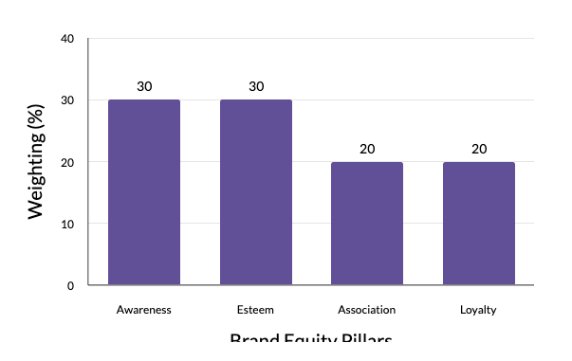
BRAND EQUITY SCORING FRAMEWORK - APPAREL INDUSTRY
W1, W2, W3, W4 = Weightings assigned based on industry benchmarks.
Each pillar is scored on a 0-100 scale, with weightings varying by industry.
The brand equity scoring framework assigns different weightings to the four key brand equity pillars in the apparel industry.
*Slide 5: The Brand Equity Scoring Framework

Slide 31



MEASURING BRAND AWARENESS - SHARE OF VOICE (SOV) ANALYSIS
Brand
Total Mentions
SOV (%)
Nike
2.5M
50%
Adidas
1.8M
36%
Under Armour
700K
14%
*Meltwater, Brandwatch, Sprinklr
©2025 Proprietary and Confidential. All Rights Reserved.

Slide 32

BRAND HEALTH ASSESSMENT: ANALYZING CONSUMER INSIGHTS
Analyze brand mentions across social media platforms to compute the share of voice (SOV) against key competitors. Use data sources like Meltwater, Brandwatch, and Sprinklr to track total brand mentions and calculate the relative SOV percentage.
Categorize media articles into positive, neutral, or negative sentiment, and assign weighted scores to analyze the overall media perception and narrative surrounding the brand. Leverage data sources like Factiva, Nexis Uni, and Bloomberg.
Share of Voice (SOV) Analysis
Search Trend Analysis
PR & Media Coverage
Examine the growth of branded keyword searches over a 12-24 month period using tools like Google Trends, SEMrush, and Ahrefs. This provides insights into the evolving consumer interest and search behaviors.
©2025 Proprietary and Confidential. All Rights Reserved.

Slide 33

MEASURING BRAND ASSOCIATION
1
Consumer Perception Surveys
2
Social Media Thematic Analysis
Develop surveys to measure emotional connection and brand differentiation using data sources like Ipsos, Qualtrics, and Nielsen Panels.
Identify recurring themes in consumer discussions (e.g., performance, sustainability) using AI-driven NLP tools like MonkeyLearn and Sprinklr.
3
Brand Conflation Analysis
Conduct focus groups to determine if consumers confuse Nike with competitors.
©2025 Proprietary and Confidential. All Rights Reserved.

Slide 34
CALCULATING THE BRAND EQUITY SCORE - COMPREHENSIVE FRAMEWORK
Calculating the Brand Equity Score
Example Weighting System (Apparel Industry)
Normalizing the Data
The formula for calculating the Brand Equity Score is:
Brand Equity Score = (Awareness × W1) + (Esteem × W2) + (Association × W3) + (Loyalty × W4), where W1, W2, W3, and W4 are weightings assigned based on industry benchmarks. Each component is normalized to a 0-100 scale for cross-industry comparability.
For the apparel industry, the example weighting system is:
Brand Awareness (30%), Brand Esteem (30%), Brand Association (20%), and Brand Loyalty (20%).
The data collected from multiple sources (social media, consumer surveys, financial reports) is adjusted using a min-max normalization technique to scale values from 0 to 100.
The formula for normalization is: Normalized Score = ((X - Xmin) / (Xmax - Xmin)) × 100, where X is the brand's raw score, and Xmin and Xmax represent industry-wide minimum and maximum values.
©2025 Proprietary and Confidential. All Rights Reserved.

Slide 35




NIKE STRATEGIC TAKEAWAYS
Mission-Driven Marketing Wins
Sustainable Differentiation Matters
Brand Advocacy Fuels Growth
Consumers support brands aligned with their values.
Quality and ethics must be inseparable.
Loyal customers become unpaid brand ambassadors.
Nike's model showcases how purpose fuels loyalty and premium pricing.

Slide 36




THE FUTURE OF BRAND EQUITY MEASUREMENT
AI-Driven Sentiment Analysis
Predictive Analytics for Trust Forecasting
Emphasis on Authenticity and Social Impact
Leveraging natural language processing to provide real-time, granular insights into brand perception across various channels and touchpoints.
Applying machine learning models to anticipate shifts in brand trust and reputation, enabling proactive brand management.
Increased focus on measuring a brand's ability to authentically connect with consumers and drive positive social and environmental change.
As consumer expectations evolve, the future of brand equity measurement will rely on innovative technologies and a deeper understanding of the multifaceted drivers of brand value.

Slide 37




FINAL TAKEAWAYS
Brand Equity is measurable and actionable.
Strategic brand management strengthens long-term brand resilience.
Nike's model showcases how purpose fuels loyalty and premium pricing.
The four pillars of brand equity - awareness, esteem, association, and loyalty - can be quantified through a variety of data sources and analytical techniques.
Proactively measuring and optimizing brand equity helps companies navigate market changes, maintain relevance, and preserve their competitive edge.
By aligning its brand with strong environmental and social values, Patagonia has cultivated deep customer devotion and the ability to charge higher prices.
Building a robust, purpose-driven brand equity is key to long-term business success. Companies must continuously measure and evolve their brand strategies to stay ahead of shifting consumer demands and market dynamics.

Slide 38
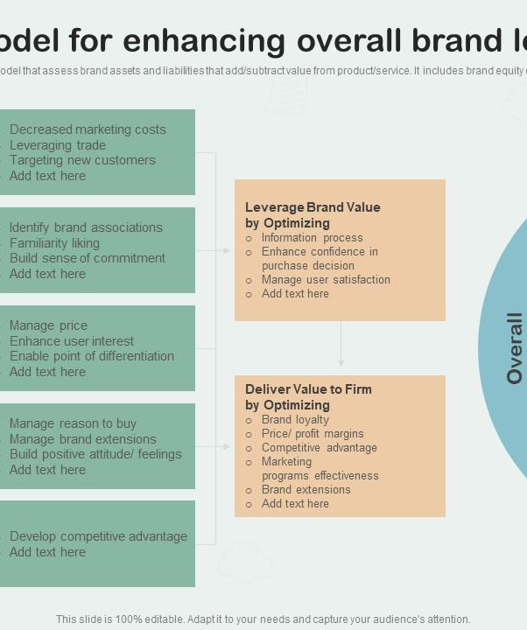
NEXT STEPS & Q&A
This slide invites the audience to engage in an interactive brand equity assessment session and poses thought-provoking questions about how their brand can apply Patagonia's model to drive sustainable growth and customer loyalty.

